Slide 1
Week of Innovation
One week of Innovation
Challenges that will inspire
learners to consider how to
improve the world around them.​

Slide 2
3M Week of Innovation
How can innovations solve everyday problems?
The state of science around the world is very complex. However, many people are curious and hopeful that science will help make the world a better place for future generations. This 3M Week of Innovation was created to help you think about how you can solve problems that you see impacting the world around you.
As you participate in this 3M Week of Innovation, hopefully you are inspired to consider how you can solve a problem and develop a concept that might revolutionize the way we live our lives. Your ideas can become a submission for the 3M Young Scientist Challenge.
Remember that your solution must be a new innovation or idea, and cannot simply be a new use for an existing product. The challenges are designed around the entry topic areas: Robotics, Home Improvement, Automotive, Safety, AR/VR, and Climate Tech.

Slide 3
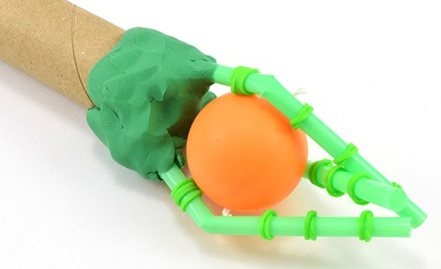
Station 1
Robotics Innovation Challenge:
Make a Robot Hand
Do you know anyone who has had a hand or an arm injured in an accident? What if you could build them a robotic hand to help them accomplish everyday tasks like writing, picking up a glass, or opening a door? This activity will show you how to build a simple robotic hand using common household materials.

Slide 4
Instructions
Follow along with the station task cards to build a simple robot hand with two "fingers" and one "joint" on each finger. Note that this project follows the engineering design process. This is just a simple design to get you started. You can modify, test, and improve upon the design to make a better or more complicated robot hand.
Keep testing your robot hand and try using it to pick things up. Try objects of different shapes, sizes, and weights. Do you notice any problems with your design? Do you have trouble picking up certain items?
How could you change your design to make it better? Try improving your design so it can do a better job of picking up different objects. Is it better if you control all the fingers with one string, or individually? What if you change the angle of the fingers relative to each other, or the location of the joints? What else can you change?
  If you are using air-dry or oven-bake clay, finalize your design before you let the clay dry.
Caution: adult supervision is required for oven-bake clay. Putting plastic drinking straws in the oven may cause them to melt, depending on the baking temperature for the clay. If you notice any funny smells or see your straws melting, immediately turn off the oven and remove the robot hand.

Slide 5
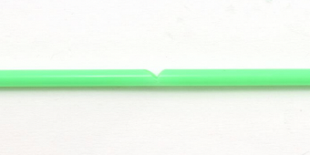
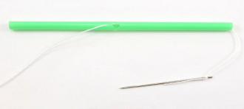
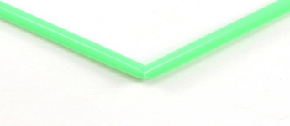
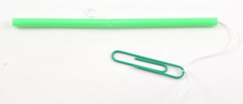
Instructions (continued)
Step 1: Cut a small triangular notch about halfway along the length of a straw. This notch is a joint in the straw finger.
Step 2: You should now be able to bend the straw at the joint like you bend a finger.
Step 3: Use a needle to poke a hole just above the notch, and thread some string through the straw. It may help to use tweezers to pull the needle through the straw.
Step 4: Tie off the string above the hole in the straw and tie a paperclip to the other end.

Slide 6
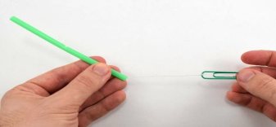
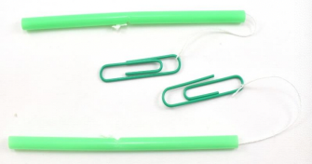
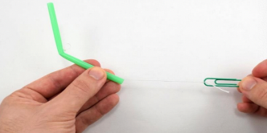
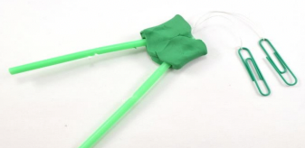
Instructions (continued)
Step 5: Hold the base of the straw with one hand and the paperclip with your other hand.
Step 6: When you pull on the paper clip, the straw should bend.
Step 7: Build a second finger just like the
first one.
Step 8: Tie off the string above the hole
in the straw, and tie a paperclip to the
other end.

Slide 7
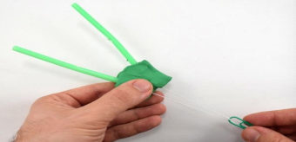
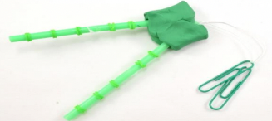
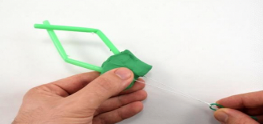
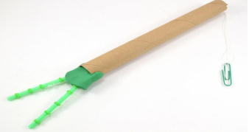
Instructions (continued)
Step 9: Hold the modelling clay with one hand and the paper clips with one hand.​
​
​
​
​
Step 10: When you pull on the paper clips, the fingers should bend.​
​
​
​
​Step 11: Wrap rubber bands around the straws. This can help improve their grip.​
​
​
​
Step 12: Attach the modelling clay to the end of a cardboard tube to form an 'arm.' You may need to tie on longer strings and thread them through the tube. You can also connect the strings to a single paper clip to control all the fingers at once.​

Slide 8
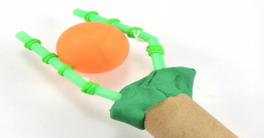
Instructions (continued)
Step 13: Now, hold the cardboard tube and pull on the string(s) to try and use your robot hand to pick up something.​
​
Optional Extension Steps: ​
Try making a more complicated finger with three joints, each controlled independently by a different string.​
Try making a hand with different combinations and orientations of fingers and joints. ​
Can you make a 'claw' like in an arcade machine? ​
What about a human hand, with a thumb and four fingers of different lengths?​

Slide 9
What Happened?
Using the materials suggested in this activity, you should be able to build a robotic hand that can pick up small, lightweight objects. Objects that are slightly squishy or have rough textures (like a block of foam) may be easier to pick up than objects that are hard and smooth (like a table tennis ball). You may find it difficult to pick up heavy objects (like a coffee mug) because the straws are not sturdy enough and will bend backwards. ​
The shape and variety of objects that you can pick up will depend heavily on how many fingers your hand has and how you arrange them. For example, you could build a hand that is very good at picking up paper cups, but has a hard time with table tennis balls, or vice versa. ​
Building a robot hand that can easily pick up a wide variety of objects, like a human hand, is a very difficult challenge that professional engineers are still working on to this day!​

Slide 10
Digging Deeper
Your hand is made up of bones, muscles, joints, and tendons. The bones provide the rigid structure for the hand, like the straws in this project. The joints provide places for the fingers to bend, like the notches in your straws. The tendons pull on the joints to make the different segments bend, just like the string in your robot hand. The muscle in your robot hand is still provided by a human, since ultimately you are the one pulling on the paper clips. Real robotic hands have electric motors in them that act like muscles.
The science of developing robotic hands, along with other artificial limbs and organs, is called prosthetics. Scientists, engineers, and doctors work together to develop artificial body parts as replacements for people who lose organs or limbs due to accidents or disease. Try searching online for other types of prosthetic limbs and organs that have been developed. You might be amazed at what you find!
For Further Exploration:
  Can you build a hand out of sturdier materials that can lift heavier objects? A trip to the hardware store might help you discover what materials you could use.
  Can you expand your robotic hand so it includes other joints? What about a wrist, or an entire arm including an elbow and shoulder?
Keep track of your observations in a table in your lab notebook.

Slide 11


Robotics
Robotics can revolutionize the way we live our everyday lives. These machines, built and programmed to perform tasks without human interference, have made it possible to perform tasks with incredible speed and accuracy. How do you think the power of robotics could impact your community?
What kind of innovation would…
Harness the power of robotics for positive change in our everyday lives?
Increase productivity using robotics?
Utilize robotics to improve businesses?
Use robotics to improve people’s experiences at schools, homes, offices, or factories?
Use robotics to improve safety measures?
For inspiration, take a look at these 3M Young Scientist Challenge alumni:
2020 finalist
Samhita
Pokkunuri
2014 Finalist​
Andrew Masek

Slide 12
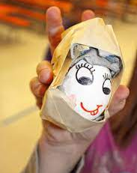
Station 2
Safety Innovation Challenge:
Create a Better Helmet
The egg drop project is a classic and time-honored tradition in many science classes. The goal is usually to build a device that can protect an egg when dropped from a high location. This activity puts a twist on the classic project, motivated by real-world concerns in the area of sports. Can you build a reusable egg drop helmet that can survive impact or repeated falls from the same height? Try this activity and find out.

Slide 13
Introduction
Football helmets contain lots of padding to help absorb the impact of a hit.
Take a look at the materials you collected and think about which ones might absorb an impact the best. Football helmets also have a harder outer layer to help evenly distribute the force of a direct hit.
Before you start, sketch a few design ideas for your egg helmet.
Think about the materials you have available and how you could use them for different purposes. For example, what can cushion the egg and absorb energy when it hits the ground? What will provide structural support to hold your egg in the helmet and your helmet together? Try to think of at least three different designs.
If you have trouble getting started, a very basic design could consist of a small cardboard box or plastic food storage container, lined with a cushioning material, with the egg placed in the middle.
Pick one of your designs and start building! Remember, real helmets are designed to be taken on and off. Remember, this is a helmet, and your design shouldn’t involve just wrapping or taping material completely around the egg. Can you design a helmet that can be easily removed and put back on? If you want to keep your egg player extra safe, you can also use some of the materials to create a face mask. Test it!

Slide 14
Test It:
Place a sheet each of newspaper and plastic on the ground. This will be the testing zone.
Hold the egg so the helmet is facing the newspaper target.
Using a ruler, hold the egg three inches above the ground and drop it.
Did the helmet keep the egg safe? If the egg cracked, try another design. If it didn’t, try dropping it from six inches and then from twelve inches.
Drop the helmet again from the same height. Repeat this process, checking for damage each time until the egg breaks or the helmet falls apart and cannot be reused. Keep track of the total number of drops it survives and write this number down.

Slide 15
What Happened?
You might have found this project surprisingly difficult! Even if the egg survives the first few drops, you might start to see wear and tear on your helmet. Taped or glued joints could start to come apart, materials might start to bend or snap, and cushioning materials like cotton balls might become compacted, decreasing their effectiveness over time.
In addition to protecting the egg, a successful re-usable device will need to minimize and distribute impact forces when landing. This means spreading the impact out over a large surface or multiple points. Testing and observing your design allows you to identify weak spots that can be fixed in future designs. This process of repeatedly designing, building, and testing—called iteration—is used by real engineers!

Slide 16
Digging Deeper
Do you notice any "weak spots" or parts of the lander that did not perform as you expected? How could you change the lander to improve its performance?
Using your observations, build a second, improved prototype of your lander and test it following the same process.
Does your improved lander survive more drops than your original?
Cleanup: Throw away any materials that are contaminated with raw egg. Use soap and water to clean up any raw egg that spilled on surfaces like floors or counters.

Slide 17
Digging Deeper (continued)
This project is a great way to learn about several classical physics concepts. When you raise an egg off the ground, it gains gravitational potential energy. When you drop the egg, the potential energy is converted into kinetic energy; the energy of motion. When the egg hits the ground, some of that energy is converted to other forms, like sound or heat, and some of it goes into breaking the egg! A protective device that can safely absorb some of this energy can help prevent the egg from breaking. The higher you start the egg, the more energy it will have—so you need to absorb more energy to keep it from breaking.​
You can also think about this in terms of Newton's second law of motion. When the egg hits the ground, it rapidly decelerates (its speed changes). Objects that experience high accelerations or decelerations feel very high forces, which can cause them to break. If you can slow down the egg's crash landing by cushioning it (or adding a parachute, so it isn't going as fast to begin with), then you will reduce the force felt by the egg and decrease its odds of breaking.​
What does all this have to do with sports? Helmets designed to handle major crash energy generally contain a layer of crushable foam. When you crash and hit a hard surface, the foam part of a helmet crushes, controlling the crash energy and extending your head's stopping time by about six thousandths of a second (6 ms) to reduce the peak impact to the brain. Rotational forces and internal strains are likely to be reduced by the crushing.​

Slide 18

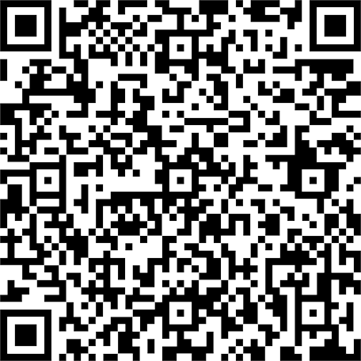
Safety
Whether you’re on the sports field or crossing the street, safety should always come first. Through science, we can improve safety measures in our everyday lives and help make the things we do and consume safer and cleaner for everyone.
What kinds of innovation would…
Improve the quality of food?
Prevent young children from accidental injuries?
Reduce the risk of injury on construction sites?
Advance the tools used to heal from a sports injury?
Prevent identity theft?
Make buildings or transportation methods more durable or reliable?
Improve safety in your community?
Improve safety in schools?
For inspiration, take a look at these 3M Young Scientist Challenge alumni:
2023 finalist​
Anish Kosaraju
​
2017 Finalist ​
Gitanjali Rao

Slide 19
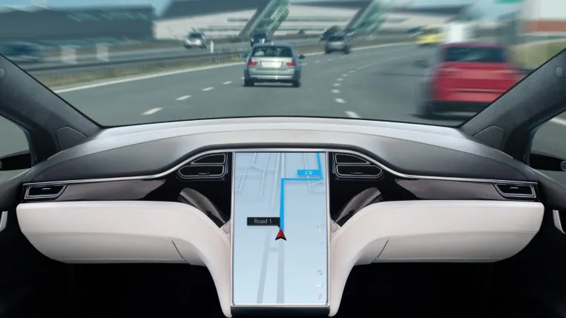
Station 3
Automotive Innovation Challenge: How Do Self-Driving Cars Know What to Do?
How do driverless cars know what to do at an intersection? How do they know when they should stop and when it is their turn to go? What about yielding to pedestrians? In this activity, you will write your own algorithm, or list of steps, for a driverless car to follow when navigating through various road scenarios like stop signs, traffic lights, and roundabouts (traffic circles).

Slide 20
Prep Work
There are many "rules of the road" that drivers must follow in order to drive safely. For example, they must stay between the lines, not drive over the speed limit, and not get too close to the car in front of them.
You might know some of these rules if you have paid attention while riding in a car. For example, you probably know that a red light means stop and a green light means go. The next time you are riding in a car, try to observe what rules the driver follows.
Certain types of roads and intersections have specific rules. For example, take a four-way intersection with stop signs and pedestrian crosswalks (see picture on slide 23).
Cars driving through this intersection have to follow several rules:
  Stop at the stop sign.
  If there are other cars that got to the intersection before you, let them go through the intersection first.
  If there are pedestrians waiting to cross in a crosswalk, let them go first.
Driverless cars, also called self-driving cars or autonomous vehicles, also have to follow all these rules.
A driverless car is controlled by a computer program instead of a human driver. It uses cameras and electronic sensors to see the world around it, detecting things like the road, traffic signs, other cars, and pedestrians.

Slide 21
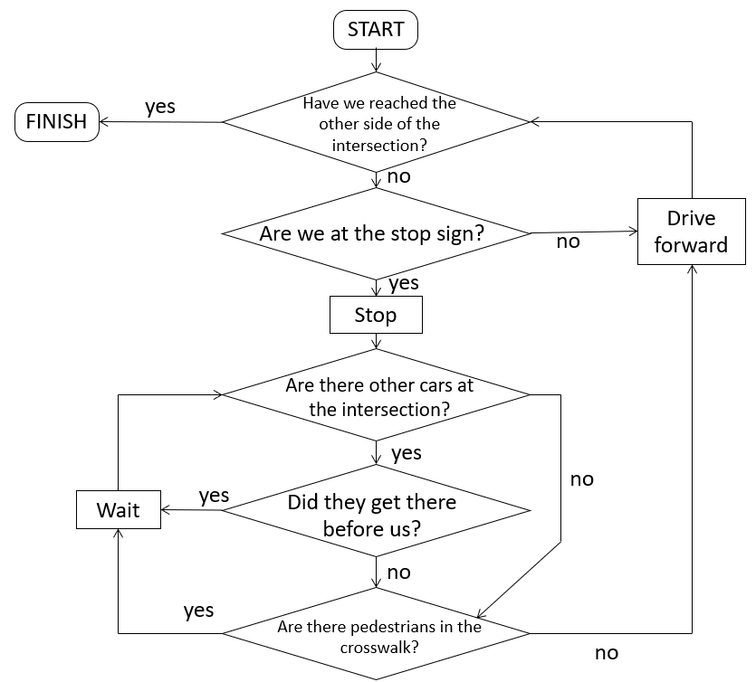
Prep Work (continued)
Computer scientists write computer programs that tell the car what to do. These programs consist of a set of steps called an algorithm.
Sometimes algorithms are represented graphically with a flowchart. A flowchart uses blocks of text and arrows to show what should happen next. This flowchart represents an algorithm that uses the rules in Step 2 to tell a car how to drive straight through the intersection.
Note that flowcharts use specific symbols for different things. A rectangle represents an action, like "stop" or "drive forward." Diamonds represent questions or decisions, like "Are we at the stop sign?" Rectangles with rounded corners represent the beginning and end of the algorithm, i.e. the "start" and "finish" blocks.

Slide 22
Instructions
Look at the driverless-car-scenarios. It contains top-down views of three different types of intersections.
For each type of intersection, make a flowchart based on rules that would help a driverless car get safely from one side of the intersection to the other.
The Prep Work section shows an example flowchart for the intersection with stop signs, but you can make your own.
Draw your entire flowchart on a piece of paper or a whiteboard. You can also write on sticky notes, put them on a whiteboard, and then draw arrows to connect them.
Next, ask yourself what happens if other drivers do not follow the rules in each scenario. For example:
  For the intersection with stop signs, what happens if another car goes through the intersection without stopping first?
  For the intersection with traffic lights, what happens if another car drives through while the light is red instead of stopping?
  For the roundabout (traffic circle), what happens if your car is already in the roundabout and another car fails to yield to you (let you go first) when entering?

Slide 23
Instructions (continued)
Can you modify your flowchart to account for unexpected behavior by other drivers or pedestrians? What about cyclists?
Try moving the Finish point in each scenario. For example, have the vehicle make a left or right turn. (You might need to ask an adult for help with the rules of the road for each scenario.) Make a new flowchart. How does your flowchart need to change?
Make a list of other things that might happen when driving. For example, what other objects might you encounter on or near the road? What types of objects would you swerve or brake to avoid (for example, a person or an animal), and which ones would you drive over (such as a small piece of trash)? How would you decide what to do?

Slide 24
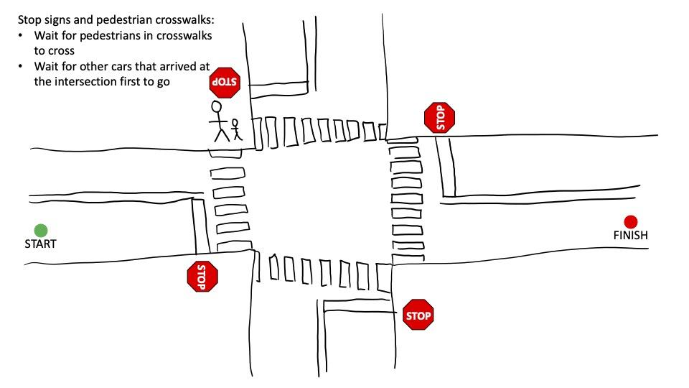
Driverless Car Scenario 1
Stop signs and pedestrian
crosswalks:
Wait for pedestrians in
crosswalks to cross
Wait for other cars that arrived
at the intersection first to go

Slide 25
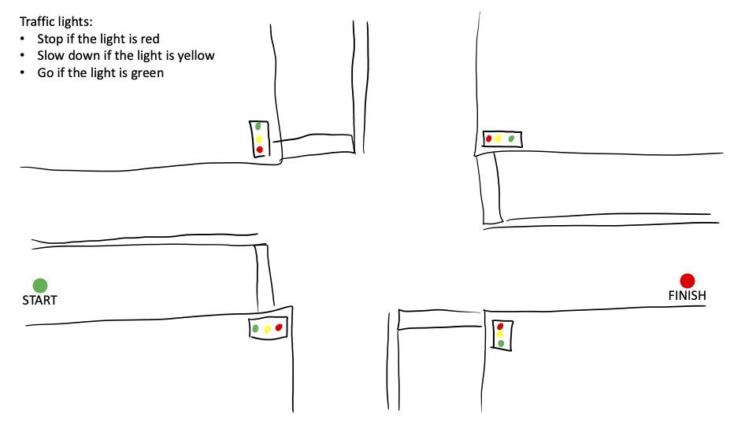
Driverless Car Scenario 2
Traffic lights:
Stop if the light is red
Slow down if the light is yellow
Go if the light is green

Slide 26
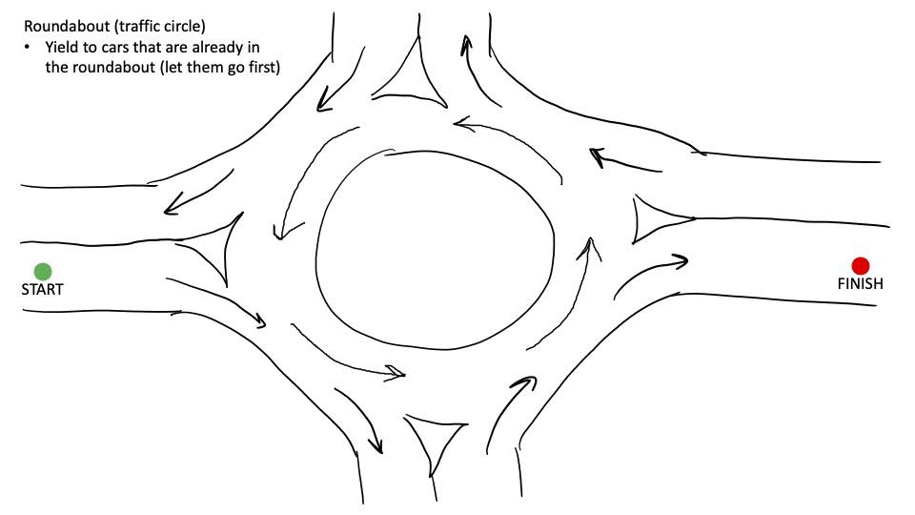
Driverless Car Scenario 3
Roundabout (traffic circle)
Yield to cars that are already in the roundabout (let them go first)

Slide 27
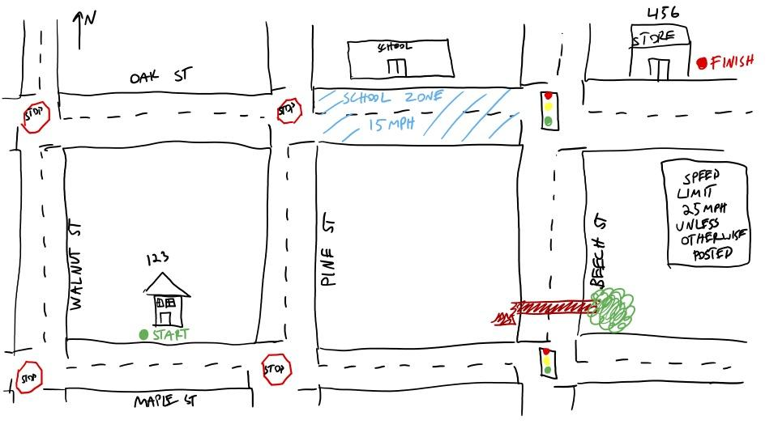
Driverless Car Scenario 4

Slide 28
What Happened?
You probably found that designing an algorithm for a driverless car is very complicated! It might be simple to write rules for a very basic scenario, like driving straight through an intersection. However, your algorithm quickly becomes more complicated when you account for unexpected behavior by other drivers or things like turning instead of going straight. Your algorithm might fail and result in a crash if you do not account for certain possibilities, like another driver running a red light. Real driverless cars need to know how to drive in many different scenarios, ranging from winding country roads to speedy highways and busy city streets.

Slide 29
Digging Deeper
There are many rules of the road that drivers must learn—when to stop, when to yield to other cars, etc. These rules can all be written down and put into an algorithm or flowchart like you did in this activity. However, it is impossible to write a computer program with a list of rules that covers every single scenario a driver might encounter.
Humans are very good at reacting to new, unexpected situations and making decisions based on very little information. For example, if a human driver suddenly sees a cow in the middle of the road, they would know to hit the brakes! However, a computer program that has only been told to look for pedestrians and other cars, and has no idea what a cow is or what one looks like, might have no idea that it should stop.

Slide 30
Digging Deeper (continued)
A human driver would also know that it is safer to drive over a small piece of trash like a napkin than to slam on the brakes and risk being hit by another car. However, a computer program that has been told to stop if there is any obstacle in the road might stop unnecessarily.
So if it is impossible to write a program that tells a driverless car exactly what to do in every possible situation, how do these algorithms work?
Real driverless cars use machine learning to "learn" how to drive. They analyze massive amounts of data, like recordings from cameras mounted on cars and actions taken by real human drivers. They use this data to learn how to do everything from identifying street signs to predicting what cars in adjacent lanes might do next.

Slide 31


Automotive
Cars are essential to many of our lives, as they allow us to move from place to place when public transportation is not an option. Scientists are finding new ways to make the automotive industry more efficient and sustainable while improving car manufacturing and design.
What kind of innovation would…
Make cars more energy efficient?
Improve the capacity of electric vehicles?
Improve safety in cars?
Help prevent car accidents?
Advance car repairs?
Help prevent car theft?
Make car assembly and manufacturing more efficient?
For inspiration, take a look at these 3M Young Scientist Challenge alumni:
2015 finalist​
Conner Pettit
​
2022 Finalist ​
Asvini
Thivakaran

Slide 32
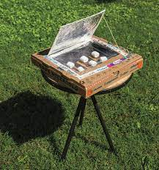
Station 4
Climate Tech Innovation Challenge:
Build a Solar Oven
Have you ever cooked something outside, like for a BBQ or while camping? It can be a lot of fun to be outdoors and enjoy eating the fruits—or burgers—of your cooking labors. Did you know that you can directly use solar power to cook food? This can be done using a solar oven, which is a low-cost, ecologically-friendly technology that seems to have everything going for it. In this science activity, you will build your very own simple solar oven out of a pizza box to gather the sun's rays and cook a tasty treat!

Slide 33
Instructions
On the top of the pizza box's lid, draw a square that is about one inch inward from each edge.​
Use a utility knife (and the ruler as a straightedge) to carefully cut along each side of the square you just drew except for the side that runs along the hinge of the box. Cut all the way through the cardboard on those three sides of the square. Then fold the flap back slightly along the attached side.​
Line the inside of the cardboard flap with aluminum foil. Fold the edges of the foil over the flap to help hold the foil in place and glue the foil onto the flap. Keep the foil as smooth as possible.​
What do you think the purpose of this foil is?​
Cover the opening made by the flap (in the lid) with a layer of plastic wrap. Attach the plastic wrap to the edges of the opening using shipping tape or black electrical tape. Make sure there are no holes in the plastic wrap, and that all of its edges are completely closed onto the lid. Why do you think it is important to make sure the plastic wrap completely seals the lid's opening?​
Line the inside of the box with aluminum foil so that when you shut the box, the entire interior is coated with foil. It is easiest to do this by covering the bottom of the box with foil, and then covering the inside part of the lid (going around the plastic-covered opening) with foil too. Glue the foil in place. Why do you think you should coat the inside of the box with foil like this?​​
Adult assistance is recommended for using the utility knife. Use caution when cooking with the solar oven as it can get quite hot!

Slide 34
Instructions (continued)
Glue or tape a sheet of black paper to the bottom of the box, centered there. This will act as your solar oven heat sink.
How do you think it will help cook your food?
Lastly, use a wooden skewer or pencil (and some tape) to prop the solar oven's lid up at about a 90-degree angle from the rest of the box. Your solar oven is ready to do some cooking!
If you want to cook a s'more, break a graham cracker in half and place a marshmallow and small piece of chocolate between the cracker halves. Place the prepared s'more on a small square of aluminum foil (slightly larger than the s'more—this will serve as a tray) and put it in your solar oven, on top of the black sheet of paper. Put the solar oven outside where it will get full, direct sunlight for at least 30 minutes, and keep the oven turned so that the flap faces the sun. When the marshmallow is soft, your s'more should be ready to eat and enjoy!
How long does it take to cook the s'more in your solar oven? Does the oven get very warm?
See images of oven.

Slide 35
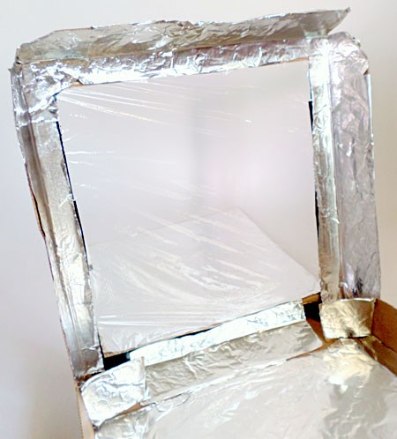
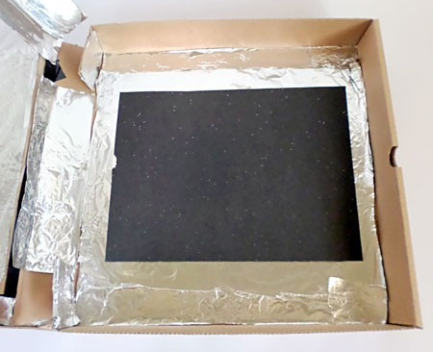
Instructions (continued)

Slide 36
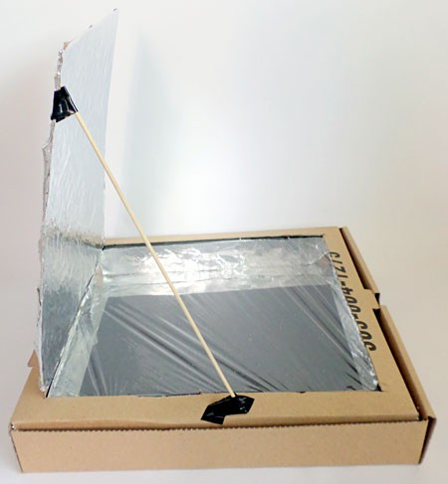
Instructions (continued)

Slide 37
What Happened?
In this activity, you built a simple box-type solar oven that should have been able to cook a s'more in sunny, warm conditions. In some trials, it took about 30–35 minutes in 85 to 90 degrees Fahrenheit heat for the marshmallow to get warm enough to become soft and melt some of the chocolate, and make a tasty, solar-powered treat! In ideal conditions, this solar oven can easily heat up to about 160 to 200 degrees Fahrenheit. Using full, direct sunlight is important for heating this solar oven.​

Slide 38
Digging Deeper
Solar ovens use solar energy—light and heat emitted from the sun—to cook food, pasteurize water, or even sterilize instruments. How does a solar oven work? The simple answer is that it is designed to absorb more heat than it releases.
The solar oven you build in this activity is a relatively simple one made out of a pizza box, aluminum foil, plastic wrap, and a sheet of black paper. You cut a flap out of the pizza box's lid and line this flap with aluminum foil so that sunlight can be reflected off of the foil and into the box. You also seal the opening with plastic wrap to create a plastic "window" that works like a greenhouse roof, allowing (direct and reflected) sunlight to pass into the box, while also retaining heat. At the bottom of the box, you placed black paper to create a "heat sink." This heat sink works by absorbing direct and reflected sunlight to become warm so that it can then heat up food placed on top of it.

Slide 39
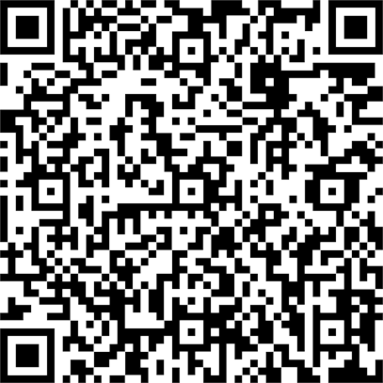

Climate Tech
Our planet holds precious resources, and it is our responsibility to properly manage them so future generations can enjoy the same quality of life that we do. As we look to tomorrow, many scientists are harnessing science-based innovations that have the potential to tackle climate-related challenges.
What kind of innovation would…
Combat rising temperatures around the globe?
Make drinking water cleaner for people across the world?
Reduce your carbon footprint?
Improve air quality?
Create new ways to use recycled materials?
Clean up our oceans and forests for wildlife?
Build more products with less material?
Make it easier for people to recycle?
Lower the cost of sustainable technology?
For inspiration, take a look at these 3M Young Scientist Challenge alumni:
2023 finalist​
Anisha Dhoot
​
2019 Finalist ​
Jordan Prawira

Slide 40
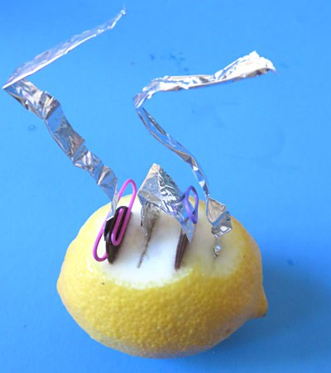
Station 5
Home Improvement Innovation Challenge: Juicy Electricity with a Lemon Battery
Consider how people around the world power their homes. What are various energy sources used in communities? What alternative energy sources could we use to help people impacted by a natural disaster?
Could we consider natural and cost-effective ways to power communities around the world? Try out this activity, and it might just charge up your imagination.

Slide 41
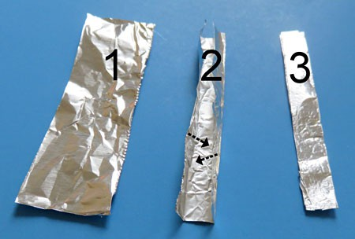
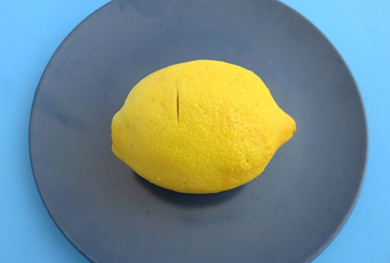
Instructions
Cut out three aluminum foil rectangles, each 3 centimeters (cm) by 20 cm. Fold each strip in thirds, lengthwise, to get three sturdy 1 cm by 20 cm aluminum strips.
Put the lemon on a plate, and carefully use the knife to make a small cut near the middle of the lemon (away from either end). Make the cut about 2 cm long and 1 cm deep.

Slide 42
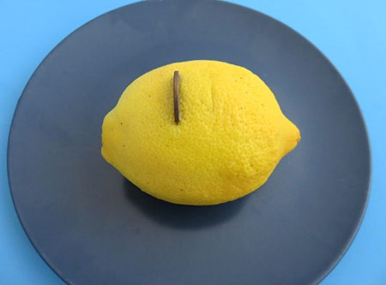
Instructions (continued)
Make a second, similar cut, parallel to the first, so the cuts are about 1 cm apart.
Push a penny in the first cut until it sits halfway down into the lemon. Part of the penny should be in contact with the lemon juice, as a chemical reaction between the copper from the penny and the lemon juice plays an essential role in generating electricity. The copper penny that is in contact with the lemon juice is called the electrode of your battery.
  Note: If your lemon has a very thick skin, you might need to cut away some lemon peel.

Slide 43
Instructions (continued)
Slide one of the aluminum strips in the second cut until you are sure part of the aluminum is in contact with the lemon juice. The aluminum strip that sits inside the lemon is the second electrode of your battery. It will react with the lemon juice to generate electricity.
  Do you think it is important for the aluminum to be in contact with the lemon juice?
You just made a battery! It has two electrodes made of different metals (copper and aluminum) and an electrolyte (the lemon juice) separating them.

Slide 44
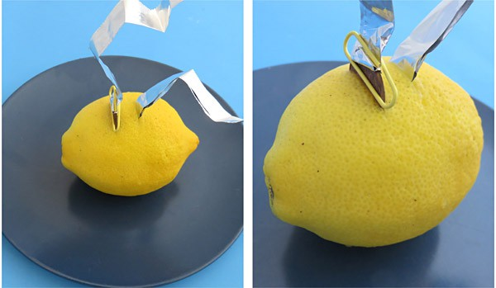
Instructions (continued)
  Do you think this battery is generating electricity or is there still something missing?
Your battery can generate electricity, but will only do so when the electrodes are connected with something that conducts electricity. To create a connection, attach the second aluminum strip to the part of the penny sticking out of the lemon with a plastic-coated paperclip. Make sure the aluminum touches the penny so electricity can pass between the copper penny and the aluminum foil.
  You used an aluminum strip to create a connection; would you expect a plastic strip to work as well?
As soon as the two aluminum strips touch each other, electricity will be produced in the battery and flow through the aluminum strips from one electrode to the other. Since you cannot see the electricity flowing, let us try to feel it. Let the two strips of aluminum touch a sensitive area on your body, like your fingertip or tongue, with about 1 cm in between the places where the aluminum touches the body part.

Slide 45
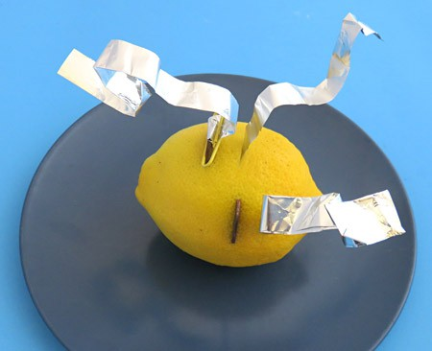
Instructions (continued)
Some of our test people needed a slightly more powerful battery before they could feel the tingly sensation created by the electricity. To increase the power, build a second battery, identical to the first. Remember a battery consists of two electrodes (the copper penny and the aluminum foil) separated by an electrolyte (the lemon juice). You can choose a different spot on the lemon you just used (as shown in the figure), or use a second lemon to build a second battery. Note that you only need one aluminum strip to build a second battery. You will create connections in the next step.

Slide 46
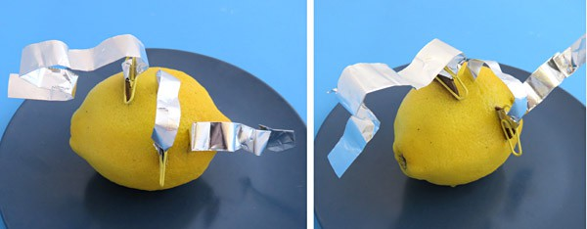
Instructions (continued)
To connect the second battery to the first, find the aluminum strip of the first battery that serves as an electrode (it has its end inserted in the lemon). Use a plastic-coated paperclip to attach the other end of this aluminum strip to the penny of the second battery (which, if you are using one lemon, is just on another part of your lemon). This connects the aluminum electrode of the first battery to the copper electrode of the second battery.​

Slide 47
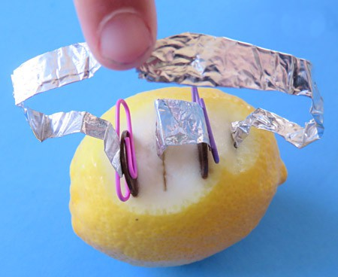
Instructions (continued)
Test this set of connected batteries in a similar way as you tested the single battery, bringing the ends of the two aluminum foil strips sticking out of your battery set (those that have a free end) in contact with your fingertip or tongue.
Can you feel electricity flowing? If you could feel it the first time, is this any different?
Note that some people are able to clearly describe the intensity of the electricity flowing through their fingertip or tongue, while others will only be able say whether they feel it or not.

Slide 48
Instructions (continued)
If you still cannot feel it, check if each electrode (pennies and the aluminum strips stuck in the lemon) are inserted deep enough so they are in contact with lemon juice. Make sure there is firm contact between the penny and its attached aluminum strip, and make sure the aluminum strips are not touching each other.
If all is correct, you might need slightly more electricity to feel the tingling generated by electricity flowing through your body. You can test another person to see if they can feel the electricity, or you can add one more lemon battery to your set.
Now that you can detect whether electricity is generated or not, try some different configurations.
What happens if you let the aluminum strips touch each other and your finger or tongue?
Cleanup
Pull out your pennies and throw away the lemon and aluminum strips.

Slide 49
What Happened?
Did you instantly feel a tingling in your fingertip or tongue, or did you need two or more batteries to feel the electricity?
The tingly feeling is due to a small amount of electricity flowing through your body. The electricity was generated by your lemon battery. Connecting the aluminum strips to each other or your body allows the electricity to flow.
As soon as you let the aluminum strips touch each other, the tingly sensation disappeared. The electricity will flow through the aluminum back to the battery, which is easier than flowing through your body.
See the Explore More tab to learn more about the batteries you created. Or try our Veggie Power Battery Kit which has all the parts needed to make stronger fruit and vegetable batteries and measure the amount of electricity generated.

Slide 50
Digging Deeper
Batteries are containers that store chemical energy, which can be converted to electrical energy, or what we call electricity. They depend on a chemical reaction to generate electricity. (Side note: Chemical reactions that generate electricity are called electrochemical reactions.) The reaction typically occurs between two pieces of metal, called electrodes, and a liquid or paste, called an electrolyte. The battery you made has one copper electrode (from the penny) and one aluminum electrode (from the aluminum foil) separated by lemon juice, the electrolyte. It will generate electricity as soon as the electricity has a path to flow from one electrode to the other. You created this path using strips of aluminum, a material that conducts electricity well.
By connecting your battery to a body part, you allow the small amount of electricity it generates to flow through that body part. This amount of electricity can create a tingly feeling in a fingertip or tongue; two sensitive areas of the body. Experiences will differ from person to person. Some people might only feel the larger amount of electricity generated by connecting several batteries in a particular way, as described in the project.
Letting the aluminum strips touch creates a very easy way for the electricity to flow from one electrode to the other, so almost no electricity will travel through your body and the tingly sensation disappears.
Warning: Letting large amounts of electricity (like the electricity delivered by a wall outlet) flow through a body part can create serious damage. In general, batteries are safe to use in home electronics projects.

Slide 51

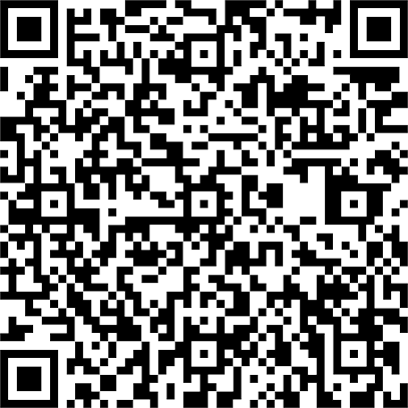
Home Improvement
Science can help us make our homes more energy efficient as well as safer and more comfortable for ourselves and our families. Think of some of the positive changes that could be made to homes through scientific innovation.
What kind of innovation would…
Reduce damage to homes during natural disasters?
Improve plumbing in homes?
Make air filtration in homes more energy efficient?
Advance security systems in homes?
Improve electrical systems in homes?
Make homes safer for young children?
More quickly and more efficiently make repairs in homes?
For inspiration, take a look at these 3M Young Scientist Challenge alumni:
2022 finalist​
Daniel Thomas
​
2018 Finalist​
Mehaa
Amirthalingam

Slide 52

Station 6
AR/VR Innovation Challenge:
Make it All Better
Innovations can make a real difference in people’s lives, especially in times of need. In this activity, you will identify innovations at your school that were created to help people or solve specific problems. Then, you will identify problems facing your community and consider how you could use AR/VR to innovate and "make it better."
AR is short for augmented reality and is used in gaming, marketing, architecture, home design, education, and more. AR augments your surroundings, while VR or virtual reality immerses you in an experience that might represent real-life or a simulated environment. VR is often using for training, gaming, education, and entertainment. How can you use AR/VR to innovate and solve an everyday problem in your community.

Slide 53
Instructions
Innovation is the “process of making improvements by introducing something new.” Innovations are often designed to solve a problem, help someone in need, or make a positive difference to a person or place. Is a fire extinguisher an innovation? It helps the entire school in case of a fire. What about a ramp? It can help those who struggle to or cannot walk upstairs to access a higher or lower surface.
  What are innovations that you use in your everyday life? What did people do/use before it was invented? Does it have any limitations?
Collaborate with a small group or partner and make a list of everyday innovations that improve lives. Answer the above questions together. Some areas you could consider are education, transportation, community safety, or healthcare.

Slide 54
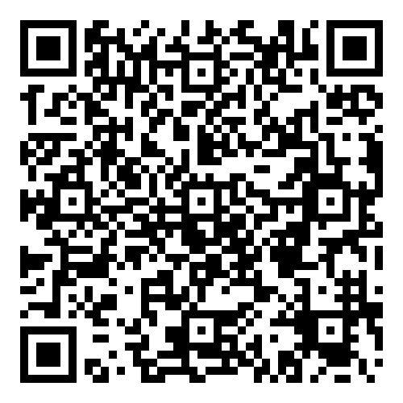
Instructions (continued)
Now consider how AR/VR could be used to innovate the solutions you listed. How would your ideas help solve everyday problems or improve an existing solution.
  How would AR/VR improve learning experiences at your school or community?
Scan the QR Code or visit:
tinyurl.com/3pxmmnx3 to discover how immersive learning is being used in classrooms.

Slide 55
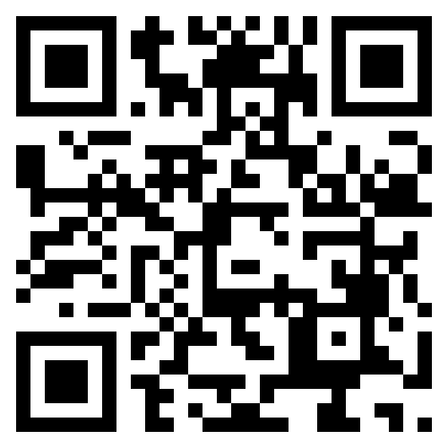
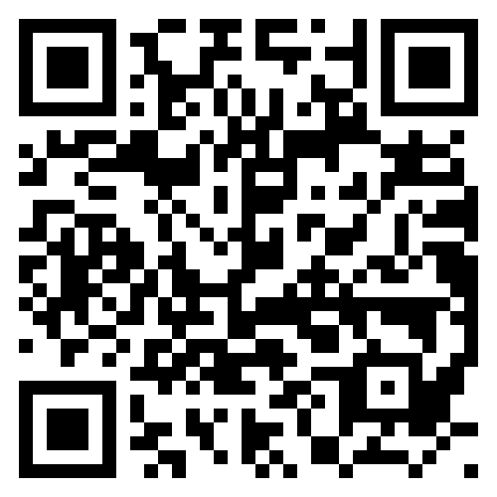
Experience and Explore AR/VR Learning
How is AR/VR being used to shape our future? Discover how 3M is transforming and shaping the world around us using AR/VR. While you explore, consider how 3M is tackling local and global problems through AR/VR.
Consider topics or ideas that were difficult for you or your classmates to learn. How could you create an experience that would immerse students in deep learning and understanding through AR/VR? Why would your experience be considered an innovation? What problems would your AR/VR experience solve?
With your partner or group, answer the following questions as you think through how you could use AR/VR to create engaging learning experiences that innovate education.
https://futures.3m.com/AR-VR
www.3m.com/3M/en_US/3m-forward-us/

Slide 56
Digging Deeper
AR/VR is a technology that really has the power to transform how and what we learn/teach. It is often highly engaging and allows users to become active participants in their learning. Using AR/VR, students can be transported to various locations or time periods without ever leaving their classrooms. They also have the opportunity to discover new perspectives by walking the footsteps of others. You can even venture to other planets or travel within the human body to discover how our cells and organs interact. Imagine the possibilities!
AR/VR can also be used to train people in the military, doctors, engineers, and other career fields! How will AR/VR revolutionize education and the way we learn? Only time will tell, and you just might be one of the innovators that helps transform education through these immersive experiences.

Slide 57
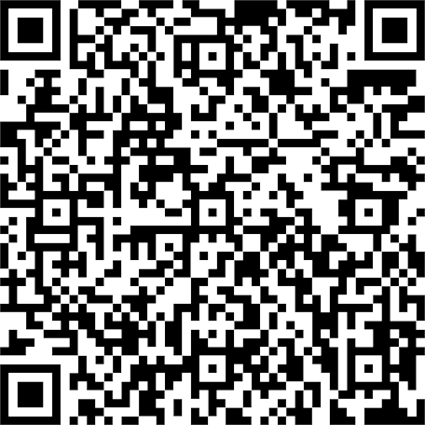
AR/VR
Augmented Reality (AR) and Virtual Reality (VR) are important technologies, because they have the power to change how we live, work, and interact with one another. How can these revolutionary technologies be used for positive change?
What kind of innovation would…
Use AR/VR to increase efficiency and productivity?
Help businesses using AR/VR?
Utilize AR/VR to improve experiences in schools and support education?
Harness AR/VR to improve safety measures in our everyday lives?
For inspiration, take a look at this 3M Young Scientist Challenge alumni:
2023 Finalist
Sean Jiang

Slide 58
Station 7
Top Ten Reasons to Participate
These are our favorite reasons to enter the 3M Young Scientist Challenge, but there are plenty more.
Read on and be inspired.

Slide 59
Top 10 Reasons to Participate
The grand prize is $25,000!
Finalists get to work one-on-one with renowned 3M scientists–a mentoring experience you'll never forget.
Friendship! Lots of competitors and finalists share a passion for science activities and remain friends long after the competition is over.
Learning goes way beyond classroom walls and into the real world of innovating.
Competitors’ ideas and innovations can make a real difference in the world!
Finalists present their video competition ideas to a distinguished panel of judges.
No textbooks! This is original, outside-the-box dreaming, planning and innovating.
Finalists get an exclusive look inside modern science innovation at 3M–including meeting 3M’s executives and patent-holding scientists!
Being part of the science community is fun. Plus, this video competition is one science activity that makes a big impact on college résumés and essays.
You could be (drum roll, please)… America’s next Top Young Scientist!
Long-term benefits:
Participating in the 3M Young Scientist Challenge offers academic, personal, and social benefits that extend well beyond the contest framework.

Slide 60
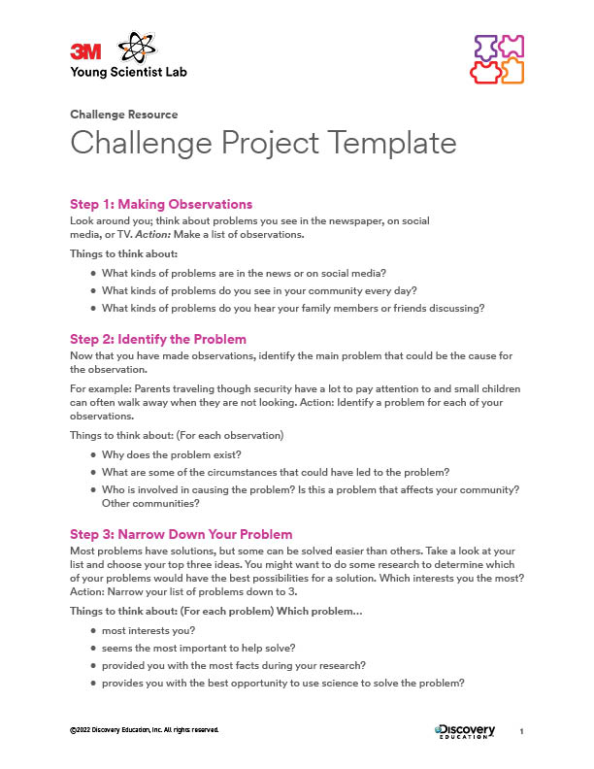
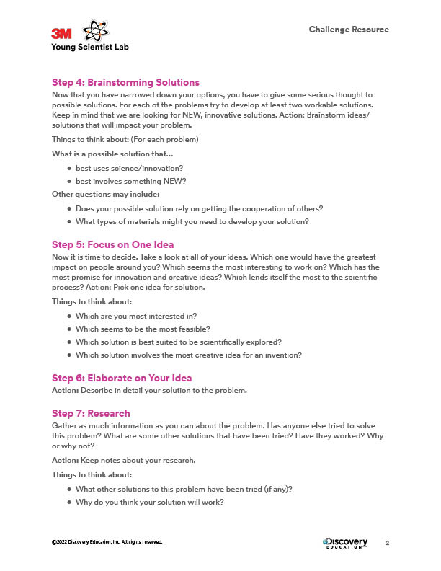
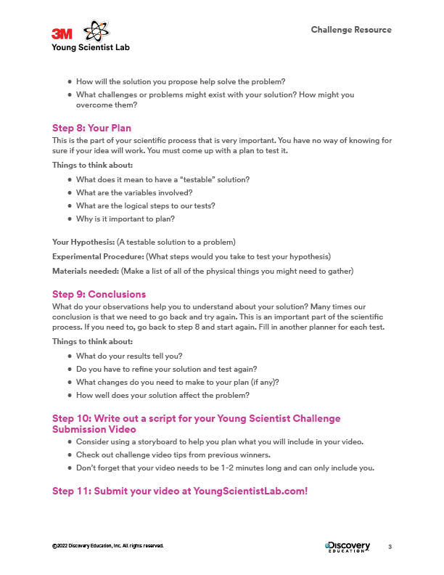
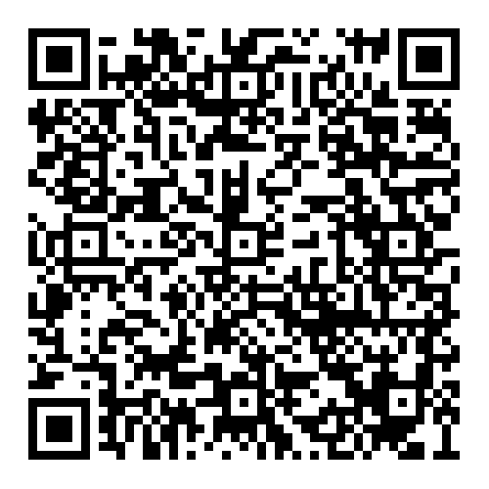
Challenge Project Template
Use this project template to create your entry. Use your science lab notebook to record your ideas and steps.
3M Young Scientist Challenge ​
Project Template​

Slide 61
Station 8
Creating Your Video
Wondering what it takes to make a winning video?
Get the scoop straight from past Top Young Scientists!

Slide 62
Challenge Video Tips
Tip #1: Be passionate about your topic
You should choose a problem you are enthusiastic about solving, come up with a solution, and communicate your ideas. Make sure to show your excitement in your entry video!
Tip #2: Plan ahead
Start by writing a script and getting all of your ideas down on paper. Storyboard your different scenes. Check out the YSC storyboard to stay organized.
Tip #3: Research, research, research!
Don’t underestimate the power of researching! It’s best if you know your topic backwards and forwards before you even begin the video. This also means looking at past entries from finalists and learning what makes a great presentation.
Tip #4: Be innovative
The 3M Young Scientist Challenge is looking for kids who can think outside the box. If you can make the judges think, “Wow, I didn't think of that!” you're off to a good start. Don't be afraid to go out on a limb with something new.
Tip #5: Communicate clearly
One of the goals of the 3M Young Scientist Challenge is to find a great science communicator. So, state your message clearly and efficiently in your video (don’t be afraid to make changes). At the finalist stage, make sure to practice being interviewed extensively.

Slide 63
Challenge Video Tips (continued)
Tip #6: Capture your audience's attention
Music sounds nice, and people like looking at pictures! Using graphics and animations makes it easier to explain science concepts, plus they just look cool. Show off your creative side–just be sure not to use any copyrighted material.
Tip #7: Keep it simple
You have a 2-minute limit. It is best to take one idea and explain it several different ways than to introduce several different ideas in such a short amount of time.
Tip #8: Show your friends, family, and teachers
Have your friends, family, and teachers watch your video before you submit it. They often have advice and ideas to help you improve. You can also get constructive criticism from a different point of view.
Tip #9: Follow the checklist
Make sure you follow all the rules and guidelines. Is your video between 1 and 2 minutes? Is your file size too big?
Tip #10: Have fun!
No, this is nothing new, but it is always important to have fun! Even entering the competition is a great life experience.
Use this station to create your storyboard and practice recording your entry video.

Slide 64
What the judges are looking for:
Description of the problem and how it affects the student, family, community, or global population.
Details about the science behind the new innovation or solution.
Clear explanations and a demonstration of how well the problem and solution are understood by the student (remember the idea must be a new innovation or solution and cannot simply be a behavioral change or a new use for an existing product).
An explanation of how the innovation could have broader reach or impact beyond the student, family, or community.
An explanation of how the student came up with their original idea.
Proper citation for any non-original materials used in the student’s entry.

Slide 65
THANK YOU!
Happy innovating!

